Slide 1

“When you are not tied….you can fly”
Mobile IP(Part 1): Need and architecture

Slide 2
Learning Objectives
Introduction to Mobile IP technology
Motivation Scenarios for use of Mobile IP in today’s context
Requirements to be followed by Mobile IP protocol
Basic entities forming Mobile IP Infrastructure
Working of Mobile IP

Slide 3
Mobile IP: Motivation Scenario
“Mobile to overtake fixed Internet access by 2014” Mary Meeker, Internet Analyst, Morgan Stanley, 2008
  Worldwide mobile phone internet user penetration was 73.4 percent and it is predicted that in 2017, more than 90 percent of internet users will access internet through their phones(Statistica.com)

Slide 4
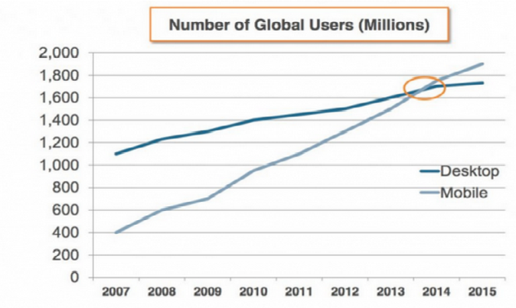
  Picture Courtesy: Morgan Stanley

Slide 5
Mobile IP: Motivation Scenario
  Mobile phones are now computers on move
  Mobile computing is emerging as a paradigm of future
  Mobile components using Internet is becoming myriad from naïve phones laptops to cars, trucks, wearable devices
  Seamless computing and uninterrupted data networking facility is requirement of mobile computing
  Mobility management is an important requirement in telephony as well as in heterogeneous networks
  GSM takes care of mobility in telephony but not in networks

Slide 6
Need of Evolution of Mobile IP
Point of attachment of TCP connection-SOCKET
SOCKET=IP address + Port number
IP address identifies the device logically, Port number identifies the application where the packet is to be delivered
IP address = Network portion + Host portion
75.126.113.230
Port no. is application specific so is constant but IP address changes when device moves from one network to another resulting in change in socket pair ultimately in loss of TCP connection.

Slide 7
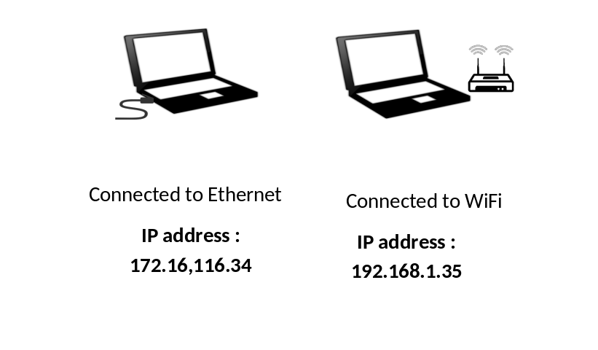
Immediate Solutions
DHCP
Issues with DHCP
A new IP address should be assigned to it when it moves to a new network so that the packet can be forwarded to that address .
New address will not be noticed through the network and the device will not be found on the internet.
Above issue can be handled by dynamic DNS but it does not work when mobile device moves too frequently because frequent updating of DNS can be expensive
Notes:
Dynamic Host Configuration Protocol
Dynamic Host Configuration Protocol (DHCP) is a network management protocol used to dynamically assign an IP address to nay device, or node, on a network so they can communicate using IP (Internet Protocol). DHCP automates and centrally manages these configurations. There is no need to manually assign IP addresses to new devices. Therefore, there is no requirement for any user configuration to connect to a DHCP based network.
DHCP can be implemented on local networks as well as large enterprise networks. DHCP is the default protocol used by the most routers and networking equipment. DHCP is also called RFC (Request for comments) 2131.
DHCP does the following:
DHCP manages the provision of all the nodes or devices added or dropped from the network.
DHCP maintains the unique IP address of the host using a DHCP server.
It sends a request to the DHCP server whenever a client/node/device, which is configured to work with DHCP, connects to a network. The server acknowledges by providing an IP address to the client/node/device.
DHCP is also used to configure the proper subnet mask, default gateway and DNS server information on the node or device.
There are many versions of DCHP are available for use in IPV4 (Internet Protocol Version 4) and IPV6 (Internet Protocol Version 6).
How DHCP works
DHCP runs at the application layer of the TCP/IP protocol stack to dynamically assign IP addresses to DHCP clients/nodes and to allocate TCP/IP configuration information to the DHCP clients. Information includes subnet mask information, default gateway, IP addresses and domain name system addresses.
DHCP is based on client-server protocol in which servers manage a pool of unique IP addresses, as well as information about client configuration parameters, and assign addresses out of those address pools.
The DHCP lease process works as follows:
First of all, a client (network device) must be connected to the internet.
DHCP clients request an IP address. Typically, client broadcasts a query for this information.
DHCP server responds to the client request by providing IP server address and other configuration information. This configuration information also includes time period, called a lease, for which the allocation is valid.
When refreshing an assignment, a DHCP clients request the same parameters, but the DHCP server may assign a new IP address. This is based on the policies set by the administrator.
Components of DHCP
When working with DHCP, it is important to understand all of the components. Following are the list of components:
DHCP Server: DHCP server is a networked device running the DCHP service that holds IP addresses and related configuration information. This is typically a server or a router but could be anything that acts as a host, such as an SD-WAN appliance.
DHCP client: DHCP client is the endpoint that receives configuration information from a DHCP server. This can be any device like computer, laptop, IoT endpoint or anything else that requires connectivity to the network. Most of the devices are configured to receive DHCP information by default.
IP address pool: IP address pool is the range of addresses that are available to DHCP clients. IP addresses are typically handed out sequentially from lowest to the highest.
Subnet: Subnet is the partitioned segments of the IP networks. Subnet is used to keep networks manageable.
Lease: Lease is the length of time for which a DHCP client holds the IP address information. When a lease expires, the client has to renew it.
DHCP relay: A host or router that listens for client messages being broadcast on that network and then forwards them to a configured server. The server then sends responses back to the relay agent that passes them along to the client. DHCP relay can be used to centralize DHCP servers instead of having a server on each subnet.
Benefits of DHCP
There are following benefits of DHCP:
Centralized administration of IP configuration: DHCP IP configuration information can be stored in a single location and enables that administrator to centrally manage all IP address configuration information.
Dynamic host configuration: DHCP automates the host configuration process and eliminates the need to manually configure individual host. When TCP/IP (Transmission control protocol/Internet protocol) is first deployed or when IP infrastructure changes are required.
Seamless IP host configuration: The use of DHCP ensures that DHCP clients get accurate and timely IP configuration IP configuration parameter such as IP address, subnet mask, default gateway, IP address of DND server and so on without user intervention.
Flexibility and scalability: Using DHCP gives the administrator increased flexibility, allowing the administrator to move easily change IP configuration when the infrastructure changes.

Slide 8
Immediate Solutions
Solution
Issue
change the routing tables to create specific routes to the mobile node.
It is not at all possible practically to update routing table with the speed of mobile nodes as it may also prove a threat to the stability.

Slide 9
Mobile IP
Mobile IP protocol defined by Internet Engineering task force (IETF) and documented in IETF RFC 3344.
It allows mobile devices whose IP addresses are associated with one network to stay connected when moving to a network with a different IP address
The term “mobile” in Mobile IP signifies that all connections are maintained even if the point of attachment (socket) changes when the device moves from one network to another in contrast with DHCP which requires disconnection from one network while getting associated with another

Slide 11



Analogy to Mobile IP
Temporary Address
Permanent address
Temporary address
Permanent address

Slide 12

Mobile IP: A Stable Solution
Mobile IP allows mobile node to use two IP addresses
Home address which is known to all and is fixed
Care-of-address that changes at each new point of attachment
Home network
Foreign Network
Home Address
172.16.116.23
Care-of-address
192.168.1.35

Slide 13
Requirements of Mobile IP
Compatibility: Mobile IP should be compatible or should be integrated with the existing operating systems applications, network protocols, existing router software, lower layers of standard IP and the mobile nodes using mobile IP should be able to communicate with fixed systems without mobile IP.
Non-Transparency from higher layers: The mobile node should be non-transparent to the higher layers so that the change in point of attachment to the mobile node does not affect working of higher layers
Quick reestablishment: The mobile node after entering the foreign network suffers from a negligible disconnection for the time it acquires and registers the COA with the home agent. The reestablishment from this disruption should be fast because TCP connection is able to survive small disconnections not longer ones

Slide 14
Requirements of Mobile IP
Scalability: It should be scalable over the entire devices worldwide
Efficiency: It should not adversely affect the efficiency of the whole network
Security: The mobility of the mobile node should not be transparent to the other nodes so address should be encapsulated or hidden. It should be ensure the packets intended for a mobile node practicing mobile IP should reach it only and fake IP addresses should be avoided by proper authentication methods.

Slide 15
Mobile IP Architecture
Entities:
Mobile Nodes (MN) An end system which can be phone, laptop, a vehicle or a router on board aircraft which moves from one subnet to subnet changing its point of attachment.
Correspondent Node (CN) Correspondent Node is one of the many partners for the mobile node. It can be fixed or mobile node. It is connected to a router and sends messages to the mobile node which can be in home network or foreign network.
Home Network (HN) Subnet of the network to which the mobile node belongs.
Foreign Network (FN) Subnet of the network in which the mobile node currently resides.
Home Address Original states IP address of the node known to all as the identity of the node.

Slide 16
Mobile IP Architecture
Care-of-address (COA) Temporary IP address of the mobile node assigned according to the foreign network where the mobile node currently is. All the packets intended for the mobile node are sent at COA. The COA can be
Foreign Agent Care-of-address: Foreign Agent Care-of-address is the IP address of the foreign agent.
Collocated Care-of-address: The IP address temporary acquired by the mobile node. Not optimal in the scenario of scarcity of IP addresses in IPv4 Scheme.
Foreign Agent(FA) It is the router on the foreign network to which the mobile node is configured. It assigns temporary care-of-addresses to the mobile nodes and forwards the packets received from HA to the mobile node.

Slide 17
Mobile IP Architecture
Home Agent (HA)Router on a mobile node’s home network which forwards data packets intended for mobile node .
maintains information about current location of the mobile node.
Following can be locations of Home Agent:
Router for the home network. This is the most appropriate location. But it requires changes in the software of the router.
Any arbitrary node in the subnet. A problem associated with this approach is that the data packet has to cross the router twice when mobile node is in the foreign network.
Router is Home Agent but it is just a manager for virtual Home network of the mobile node.

Slide 18
Home network of A
172.16.116.23
Foreign Network
Receiver
MN(A)
192.168.1.35
4
3
INTERNET
Home Agent
2
Foreign Agent
5
1
Sender
CN(X)
When CN is fixed and Mobile Node is in foreign network

Slide 19
Working of Mobile IP
Correspondent Node (CN) X wants to transmit packets to Mobile Nodes (MN) A.
  The Home address of A is 172.16.116.23 .
  X sends the packet with 172.16.116.23 as destination IP address.
  The packet is routed to A’s home network.
  HA receives the packet
A is in a foreign network with current Care-Of-Address (COA) as 192.168.1.35.
  Home agent is informed of this address.
  HA encapsulates the entire datagram inside a new datagram with A’s Care-Of-address (COA) as the destination and its own address as source and send the packet

Slide 20
Working of Mobile IP
The transmitted datagram received by Foreign Agent (FA) of the foreign network. It strips the outer header and delivers the original datagram to A.
The respond of the message can be send from A to CN through the router of the foreign network as if it was a fixed node. If it is a mobile node, same procedure is followed in reverse direction.
The mobile node continues to send and receive packets as if it was in its own home network. That is the beauty of Mobile IP

Slide 21
Case 1
CN is fixed node and MN is in home network
CN transmits a packet using IP Protocol
The HA receives the packet
Using the information that MN is in the home network delivers the packet to MN
It gets the response packet from MN and delivers it to CN

Slide 22
Case 1
Home network of A
192.168.1.35
Home Agent
Sender
CN(X)
When CN is fixed and Mobile Node is in Home network

Slide 23
Case 2
CN is a mobile node in its home network, MN is in its home network.
In this case the packet from CN is forwarded to HA by HA_{C}
HA forward it to MN.
In the response case, MN sends packet to HA which forwards it to HA_{C}
HA_{C} delivers to CN.

Slide 24
Case 2
Home network of CN
Home network of CN
192.168.1.35
Home Agent HA_{C}
Home Agent (HA)
Both CN and MN are mobile and in their home networks

Slide 25
Case 3
CN is mobile node in foreign network with foreign agent FA_{C} and MN is in its home network with HA as its home agent.
CN transmits to FA_{C}
FA_{C} transfers the packet to HA
HA delivers it to the MN.

Slide 26
Foreign network of CN
Home network of MN
Home network of CN
192.168.1.35
Foreign Agent FA_{C}
Home Agent (HA)
Home Agent HA_{C}
when CN is mobile in its foreign network and Mobile Node is in Home network

Slide 27
CN is a mobile node at the home network with agent HA_{C} and MN is at a foreign network with agent FA
MN transmits to CN.
MN transmits to FA
FA transmits to HA_{C}
HA_{C} delivers the packer to CN.

Slide 28
Foreign network of MN
Home network of MN
Home network of CN
192.168.1.35
Foreign Agent FA
Home Agent (HA)
Home Agent HA_{C}
when CN is mobile in its home network and Mobile Node is in foreign network

Slide 29
Case 5 CN is a mobile node at a foreign network with agent FA_{C} and MN is also in foreign network with agent FA.
CN delivers packet to FA_{C}
FA_{C} delivers it to HA.
HA uses Care of address, encapsulates the packet with a header and forwards the packet to FA through tunneling
FA decapsulates the messages and sends it to MN.

Slide 30
Foreign network of CN
Home network of MN
192.168.1.35
Home Agent (HA)
Foreign Agent FA_{C}
Foreign network of CN
Home network of CN
Home Agent HA_{C}
Foreign Agent FA_{C}
Both CN and MN are mobile and in foreign networks

Slide 31
Summary
This module explains Evolution, Requirements, Infrastructure and working of Mobile IP
To implement its working, three phases are executed:
Discovery
Registration
Tunneling
These will be covered in the subsequent module.

Slide 32
Thanks

